Slide 1
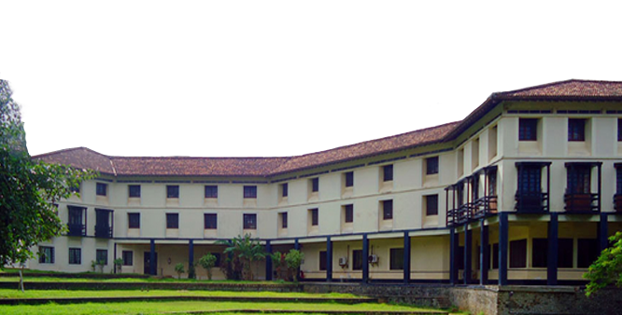
Effective use of the Ruhuna University Library resources and services
U.A.Lal Pannila
Senior Assistant Librarian
Universty of Ruhuna
jcpannila@gmail.com
0714469510

Slide 2
The University of Ruhuna
The University of Ruhuna is one of the leading Universities in Sri Lanka.
The University of Ruhuna was established by a special presidential Decree on 1st September 1978 as Ruhuna University college fulfilling a long cherished desire of the people of Southern Sri Lanka.
Today the University of Ruhuna has a proud history of about 42 years and the University consists of 10 faculties and 57 departments.
The main University premises is bordered by the sea and paddy fields and is in close proximity to Dondara, the Southern tip of Sri Lanka.

Slide 3
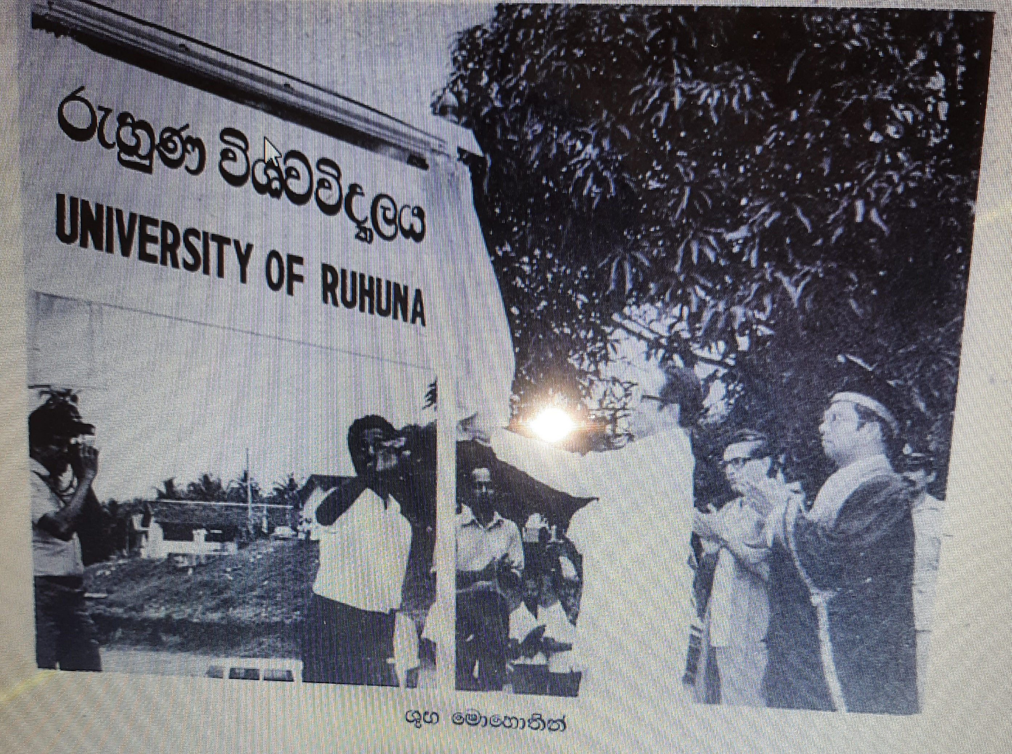

Slide 4
Main Library
Faculty of Agriculture
Faculty of Engineering
Faculty of Medicine
Faculty of Management and Finance
Faculty of Humanities and Social Sciences
Faculty of Technology
Faculty of FMST
Faculty of AHS
FGS
Faculty of Science

Slide 5
What library gives you
Library system
Human resources
Physical resources
Services

Slide 6
Human resources of the Main library
SAL Gr. I
SAL
SAL
S SAL Gr. I
Acting Librarian
In addition,
Two (01) Administrative officers
Over 28 Para professional staff members and supportive staff
Over 70 staff members are working in the UoR library system

Slide 7
LIBRARY OPENNING HOURS
Week Days 8.00 a.m. - 6.00 p.m.
Saturday 8.30 a.m. - 5.30 p.m.
Self Learning Aria is opening every day from 8.00 am to 10. 00 pm (new Building)
During the examination period, Library opening hours will be extend up to 8.00 pm
Note that:
The Library will be closed on Sundays, public holidays and Poya days.

Slide 8
LIBRARY COLLECTIONS
Lending Collection (L)
Reference Collection (R)
Quick Reference Collection
Sri Lanka Collection (SLC)
Rohana collection
Periodicals Collection
Prof. Labrooy Collection
Prof. M.A. Pemadada Collection
Legal Deposit Collection (LDC)
Color plate collection (CPC)
Dr.Kumari Jayawardhana Collection (new)
Total Books in Library
256504

Slide 9

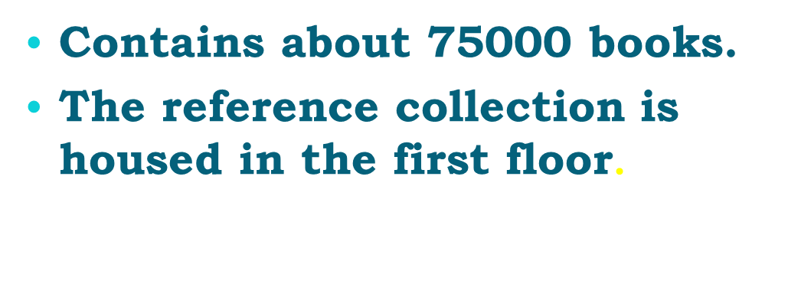
LENDING COLLECTION
Contains books of almost all the subject areas counting up to about 165,000.
The lending collection is housed in the second floor.

Slide 10
QUICK REFERENCE COLLECTION
Permanent Reference (PR)
The collection includes reference materials such as bibliographies, dictionaries, encyclopedias etc.
These are the books in demand, hence and available to use in the library.
These Permanent reference materials are not issued.

Slide 11
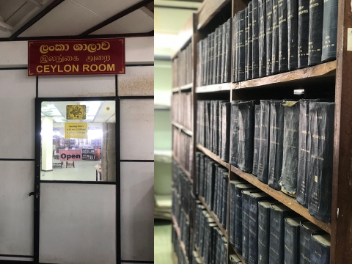

Slide 12
SRI LANKA COLLECTION
SLC
properly arranged on Historical, Social, Political information of Sri Lanka.
It is consisted of Dissertations, Undergraduates thesis, Atlases, Rare documents etc.
These sources are on permanent reference (PR) and readers are requested not to remove sources

Slide 13
ROHANA COLLECTION
RC
Specially important for the researchers who are studying on Archeological, Historical and Social studies

Slide 14
Dr.Kumari Jayawardhana Collection
Part of Dr. Kumari Jayawardena's personal collection.
Specially important for the researchers who are studying on Economics, Sociology, Historical and Social studies
These collections items are not for loan. Reference only

Slide 15
PERIODICAL COLLECTION
The collection comprises back issues as well as current issues.
The Library presently subscribes to about 190 titles of current periodicals and
e-journals. http://www.lib.ruh.ac.lk/
http://www.doaj.org/ http://en.wikipedia.org/wiki/Main_Page
Periodicals have been arranged alphabetically and are not loaned but can be read in the library.

Slide 16
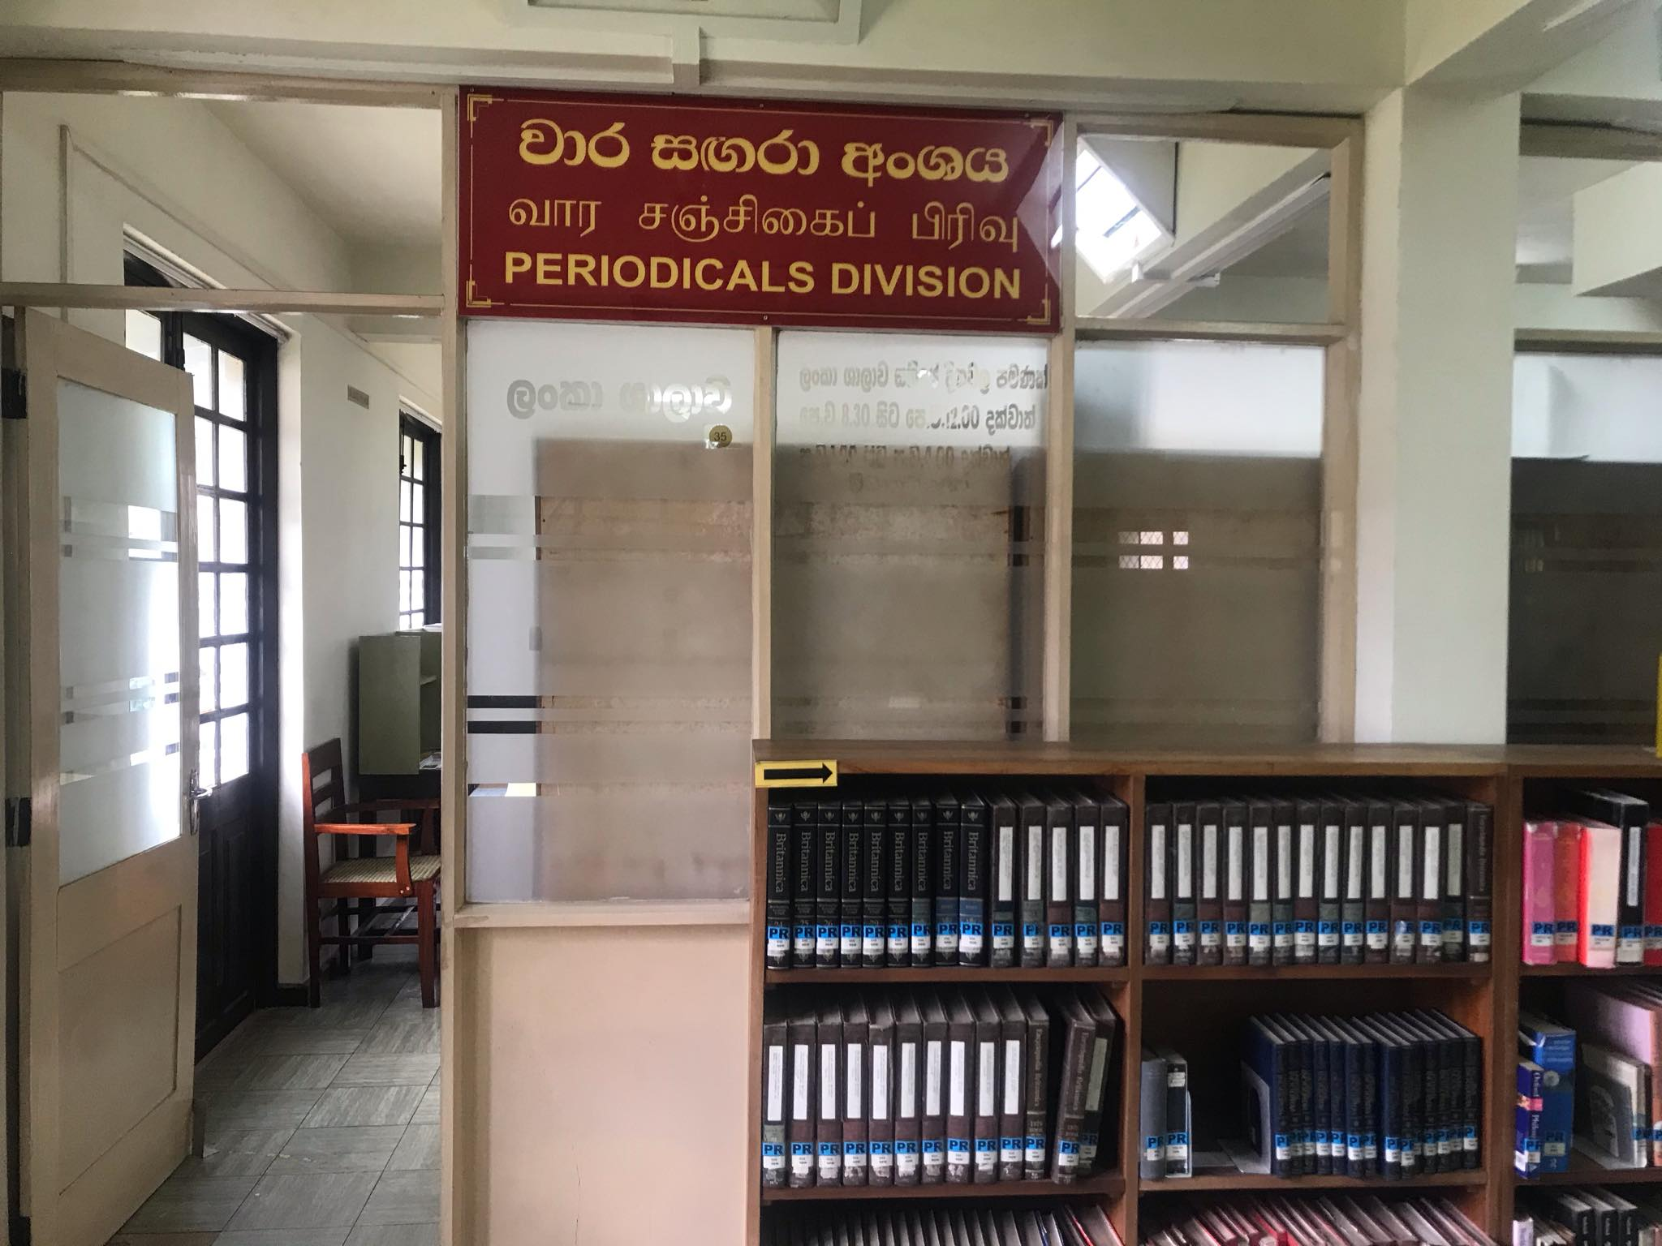

Slide 17
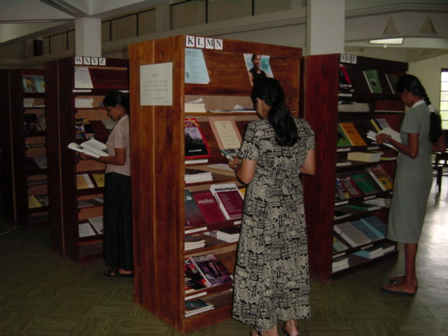
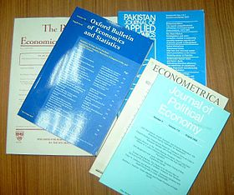

Contains local and international printed periodicals
Periodical will be issued for photocopying only
Opening hours – 8.30 a.m. to 4.00 p.m.

Slide 18
Legal deposit collection
(LDC)
LDC was established in the University on 2013
Comprises copies of 160,000 publications made in Sri Lanka since 1990
You can search the contents of the LDC through the library OPAC
These items are not for loan. Reference only
LDC is located in the 1st Floor of the new library building

Slide 19
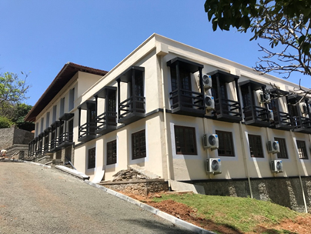

Slide 20
Multimedia collection
Audio tapes
VHS tapes
CD/DVD collection
Audio Books (visually impaired users)
E-Books
USB flash drives
Weblink for online resources
Multimedia collection consists with nearly 3000 items

Slide 21
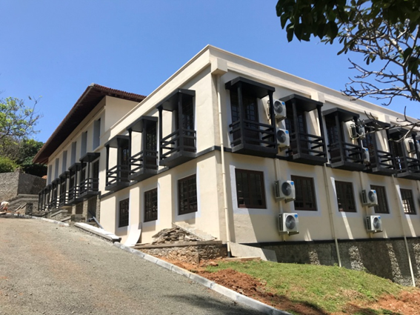
Ground Floor
Library Office
Registration desk
Counter
First Floor
New building
Reference Collection
Periodicals Collection
University museum
Legal deposit collection
Reading Room
Second Floor
Lending Collection
Sri Lanka Collection

Slide 22
Special Services
Inter-Library Loans
Internet Services
Photocopying
Reference inquiry services
Self learning area with free Wi-Fi access (at the new library building)
Back volumes service (at the new library building

Slide 23

Students Frequently Asked Questions ?
Who can borrow?
How do I register for obtaining library resources?
What can I borrow from the library and for how long ?
How many items may I borrow?
Where are my course text books?
How do I use catalogue for finding library resources?
How do I take books out?
Where do I return books?
What happens if I return a book late?
What happens if I lose or damage a library book?
Where and how can I pay my library fines?
When does my library Registration expire?
Where can I find more help?

Slide 24
Who can borrow?
There are 3 main groups of library users.
Registered students
i. Undergraduate
ii. Postgraduate
Members of the Staff of Ruhuna University.( Academics & Non Academics)
In addition we Provide information services for national and international external scholars.

Slide 25
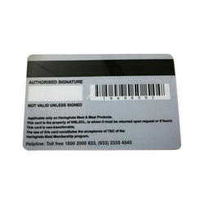
Getting the membership of the library
All Students of Ruhuna University are required to register at the Library by applying on the form provided by the Library.
They are required to produce their duly endorsed University Identity Card and Record Book at the time of registration.
At the beginning of each academic session, undergraduate and postgraduate students spending more than one academic year are required to register in the Library, by revaluation their Library membership.
Students are registered at the “user registration” section of the library
You can borrow books from the library using your student Identity cards.

Slide 26
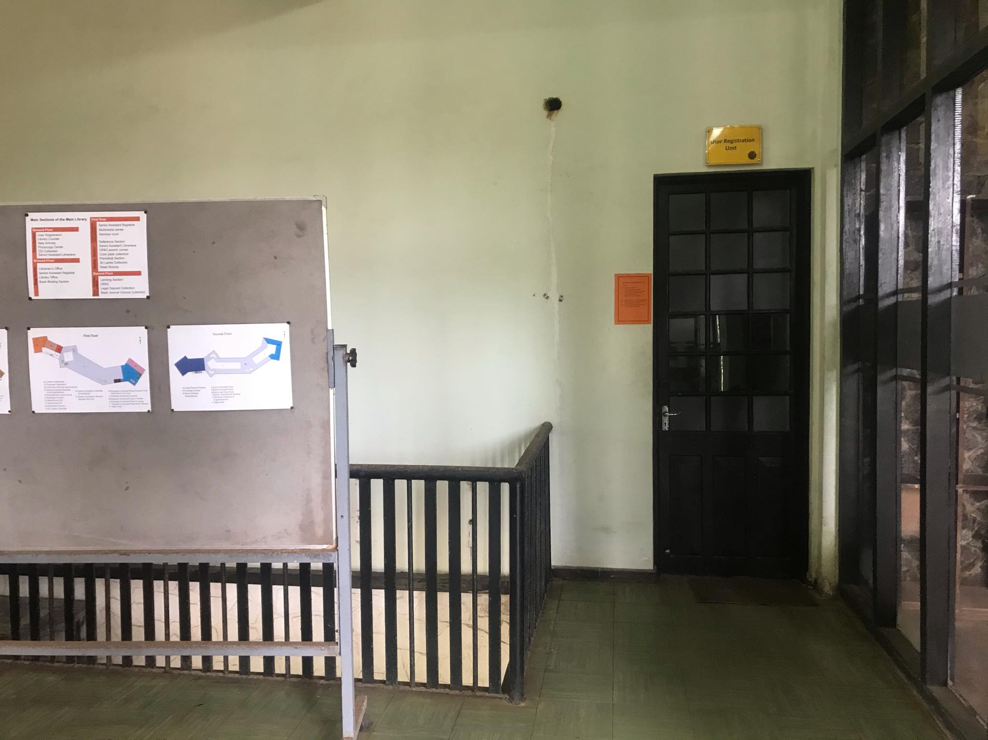
Registration desk (Office)

Slide 27
What can I borrow from the library and for how long ?
Most Books, CDs can be borrowed for the standard loan period .
The standard loan period for a book and a CD is two weeks.
Reference books are issued on week days between 3.00 p.m. to 5.oo p.m. and must be returned by 10.00 a.m. If you take them out after 3 p.m. on Friday they'll be due back at 10 a.m. on Monday.

Slide 28
How do I borrow?
Having found the items you wish to borrow, bring them to the Library counter with your University ID .
Please remember that you are responsible for all items recorded on your library user account.

Slide 29
How many items may I borrow?
Year | Lending books | Reference books + Electronic media | Total books
First Year | 03 | 01+01 | 04
Second Year | 04 | 02+01 | 06
Third Year | 05 | 02+01 | 07
Fourth Year | 06 | 02+01 | 08
Postgraduate Students | 03 | - | 03

Slide 30
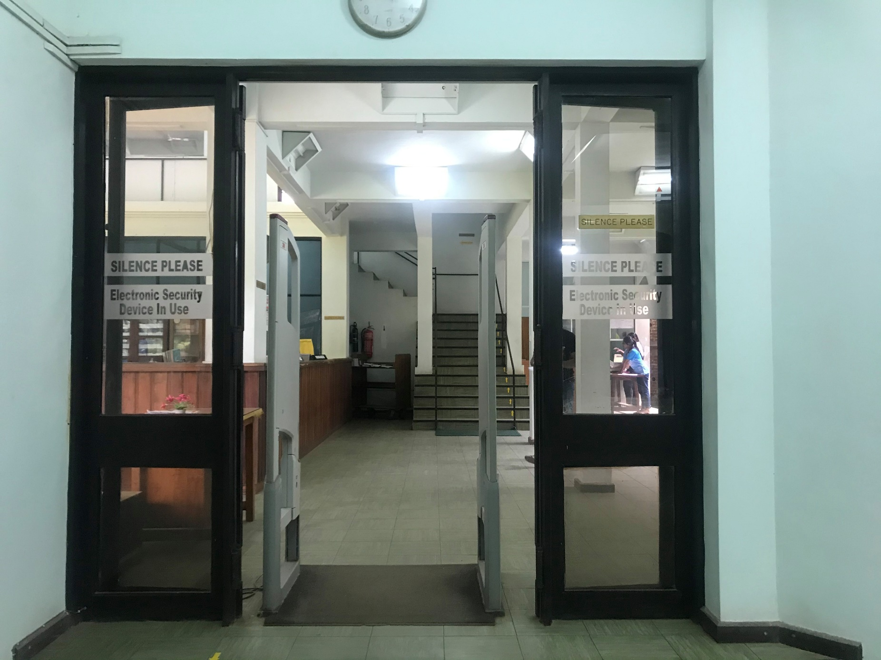
Security Gate

Slide 31
How do I use catalogue for finding library resources?
To find a book, first search our
Online Public Access Catalogue (OPAC). http://www.lib.ruh.ac.lk
This will give you details of how many copies there are, and a call number – which is a code that tells
you where the books are in the Library it is.
Books are shelved in order of the call number - so browse along the shelves until you find the section you need.

Slide 32
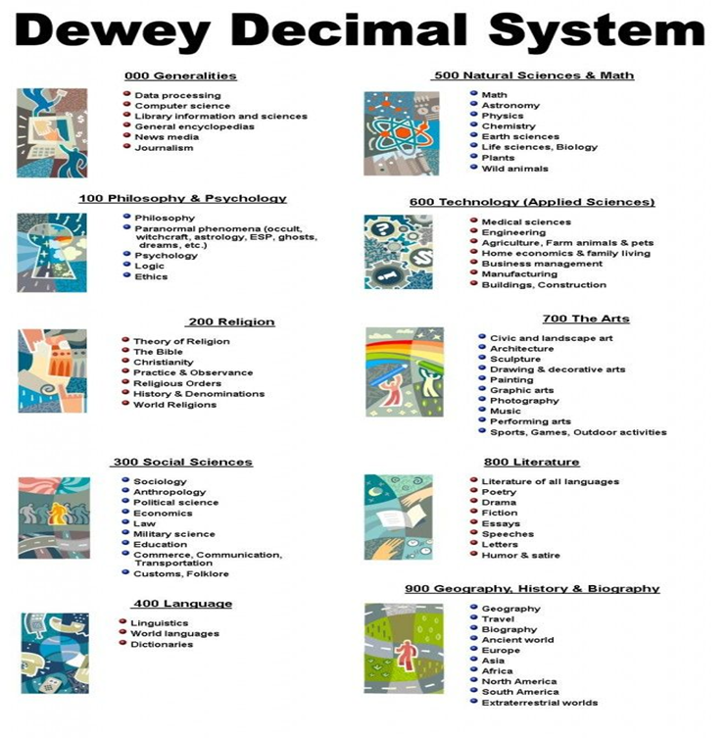
Where should I found my text books?
Ruhuna Library used DDC (Dewy Decimal Classification) System.

Slide 33
Dewy Decimal Classification (DDC)
  650 Management
  650.1 Personal success in business
  651.3 Office management
  651.5 Records management
  651.7 Communication Creation and transmission of records
  651.8 Data processing Computer applications
  652 Processes of written communication
  657 Accounting
  658 General management
  658.1 Organization and finance
  658.2 Plant management
  658.3 Personal management
  658.4 Executive management
  658.5 Management of production
  658.7 Management of materials
  658.8 management of distribution (Marketing)
  659.2 Public relations

Slide 34
How to Find Books - Continue..
To find books in the library, you may search OPAC, the online catalog, by author, title, subject, or keyword.
If you only know the author's name, use the AUTHOR begins with search, and type all or part of the author's name. When searching personal names, type the last name first. An author can be a person, corporation, association, or a conference sponsor.
When you want books about a particular subject, use one of the SUBJECT search options. If you have an exact subject heading from the Library of Congress Subject Headings, use a SUBJECT begins with search. Otherwise use a SUBJECT keyword search or ask for assistance at the reference desk.

Slide 35
If you do not know the exact author's name, title, or subject heading, use the WORDS anywhere search, or try an Advanced Search. Either option will allow you to combine search terms, for instance, an author's last name and a keyword in a title.
After you display the full record for the book, write down the owning library, the complete call number, the sub-location, and the status, then go to the shelves to get the book. http://www.lib.ruh.ac.lk
If you want to borrow a book, take it to the counter in the library.

Slide 36
Online Public Access Catalogue (OPAC)
Using OPAC you can search library materials available in main library and branch libraries of University of Ruhuna.
URL - http://opac.lib.ruh.ac.lk

Slide 37
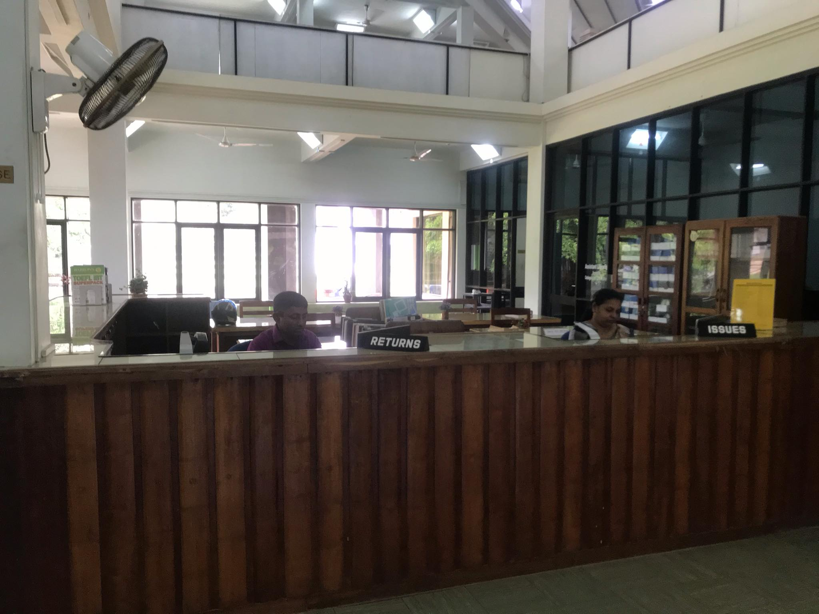
How do I take books out?
If you want to take books out, take it to the counter in the library with your University ID or student record book.
Library counter

Slide 38
Where do I return books?
Return all library items in person to the returning desk of the Library counter.
Note that:
It is your responsibility to verify your books are issued or returned correctly through your online account.
You have the one and only responsibility of your personal library account.
Contact the SAL/ Reader services or the Library academic staff for any information regarding your library account.

Slide 39
What happens if I return a book late?
Fines are calculated on overdue materials, as follows:
Rs. 1.00 per day for overdue lending items.
  Rs. 2.50 per first day for overdue reference items ® and for the other days are fined Rs.3.00 per day.

Slide 40
What happens if I lose or damage a library book ?
If an issued book is lost or damaged, the matter should be reported to the Library immediately.
Borrower has to replace it with a new copy of the same edition/ subsequent edition within the due date. If it is not available in the market, you will be billed for the replacement cost of the book plus a processing fee of 25% from the value of the book.
Note that:
All library resources on loan must be returned, and all outstanding fines paid, when a student leaves the University. Users who fail to fulfill their obligations may have their degree certificate withheld until they have returned the books and paid the fines.

Slide 41
Where and how can I pay my library fines?
You can pay your library fines at the shroff counter of the university. You can pay in person with cash.

Slide 42
Other Services
Inter Library Loan System
  Books and periodical articles which are not available in the library could be obtained as an inter library loan from other libraries.
  This service is limited. Such request have to be made to the Senior Assistant Librarian/ Reader Service.
  Or through your online library account
Photo-copying Services
  The Library provides photocopying service for reader at a very low price.

Slide 43
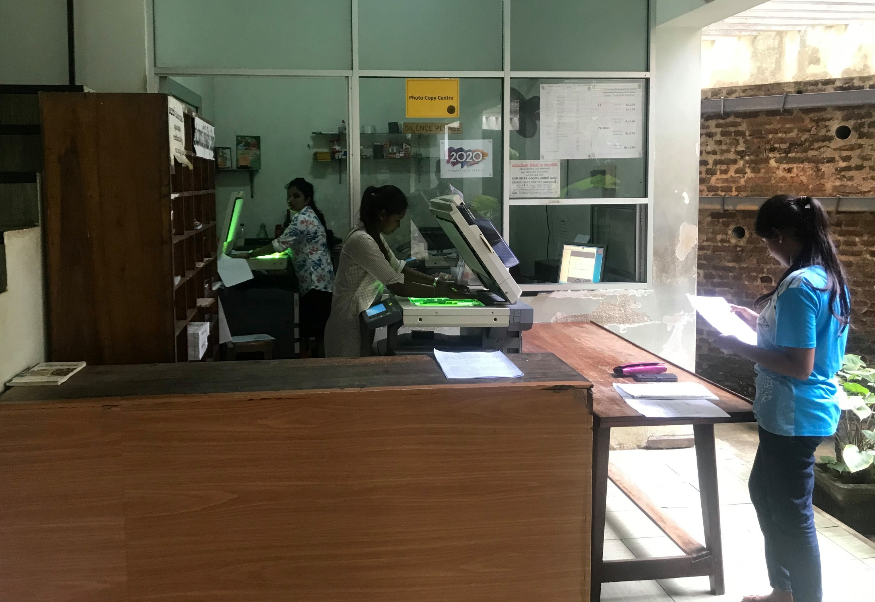

Slide 44
Institutional Repository
You can access to softcopies of documents, Audio and video contents from this library
Access through the URL: http://ir.lib.ruh.ac.lk
What you can found there
  Thesis and Dissertations
  Research publications
  Past examination papers (need access)
  University publications etc..

Slide 45
Where can I find more help?
The Library Website http://www.lib.ruh.ac.lk has a lot of useful information, and you can find lots of our resources and services around the Library.
You can contact any academic member of the library staff regarding your inquiries.

Slide 46




General Guidelines
Always have your University ID or Students record book with you.
Silence should be observed in all public reading and other service areas.
Readers should switch their cell phones during the time they are in the Library.
Readers are not permitted to bring bags, parcels, books or copies of any printed materials, umbrellas, food items, water bottles or any personal belongings in the library

Slide 47
Dos and don’ts cont.…
Library provides 'open access' facility. Therefore, you can get any book from shelves. However, Users are advised not to replace the books on shelves. They should leave the books on tables after use.
Marking, underlining, writing or defacing the books in the library in any form, if detected, will lead to fining and other punishments.
We are allowed you to bring your laptops with the charger only to the library. You can keep the laptop case at the clock room outside the library.
You should hold the responsibility of your personal belongings at the library premises.

Slide 48
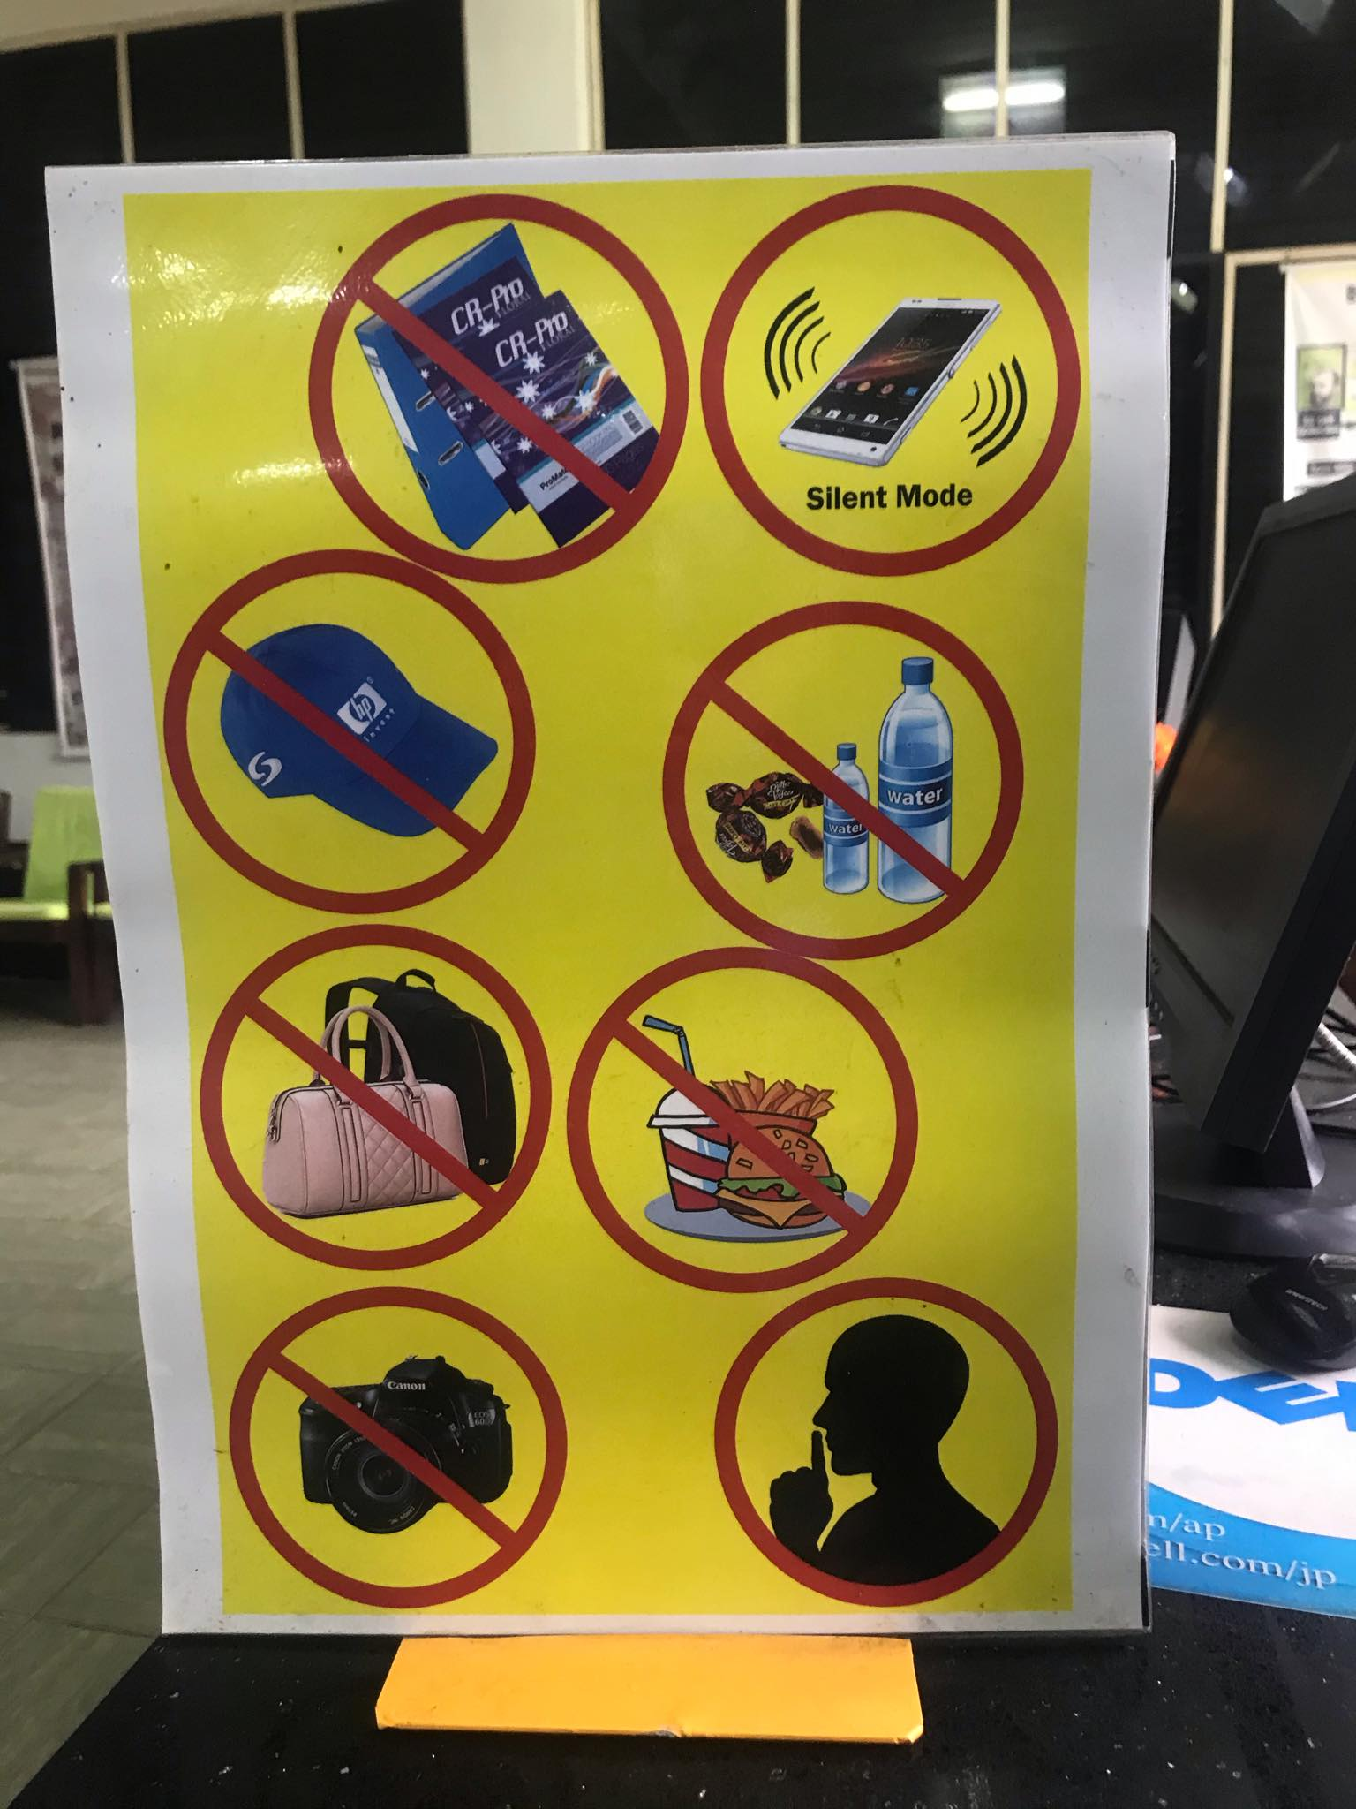

Slide 49
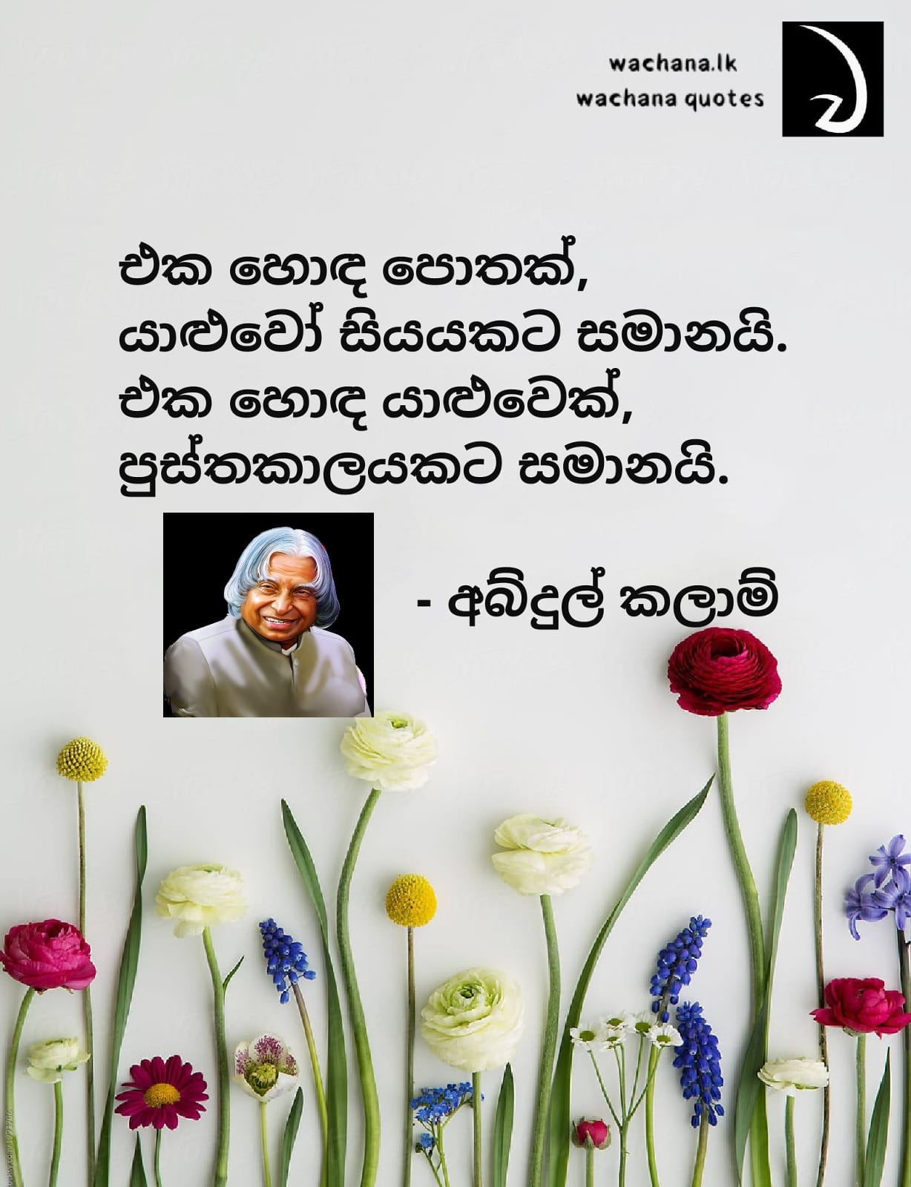

Slide 50
If You have any question Don't hesitate to contact Library staff
Thank You !!

